Slide 1
March 30th Sprint Presentation
Capstone Defence

Slide 2
User Stories (Sprint 6)
As a gamer, I want to know the HP of the enemies while playing the game.
As a gamer, I want to know the HP of my character at any time.
As a gamer, I want to see how many enemies that are spawned.
As a gamer, I want to chop down more trees.
As a gamer, I want more enemies to be spawned to make the game more fun to play.

Slide 3
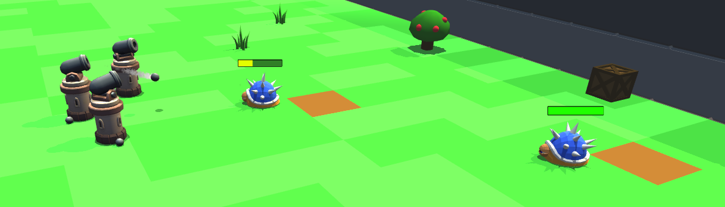
Enemy HP Implementation
Enemies have unique health bars above their heads now
Health bars are modular and can be increased, Allow for modifiers and Attack Damage and rate are similar.

Slide 4
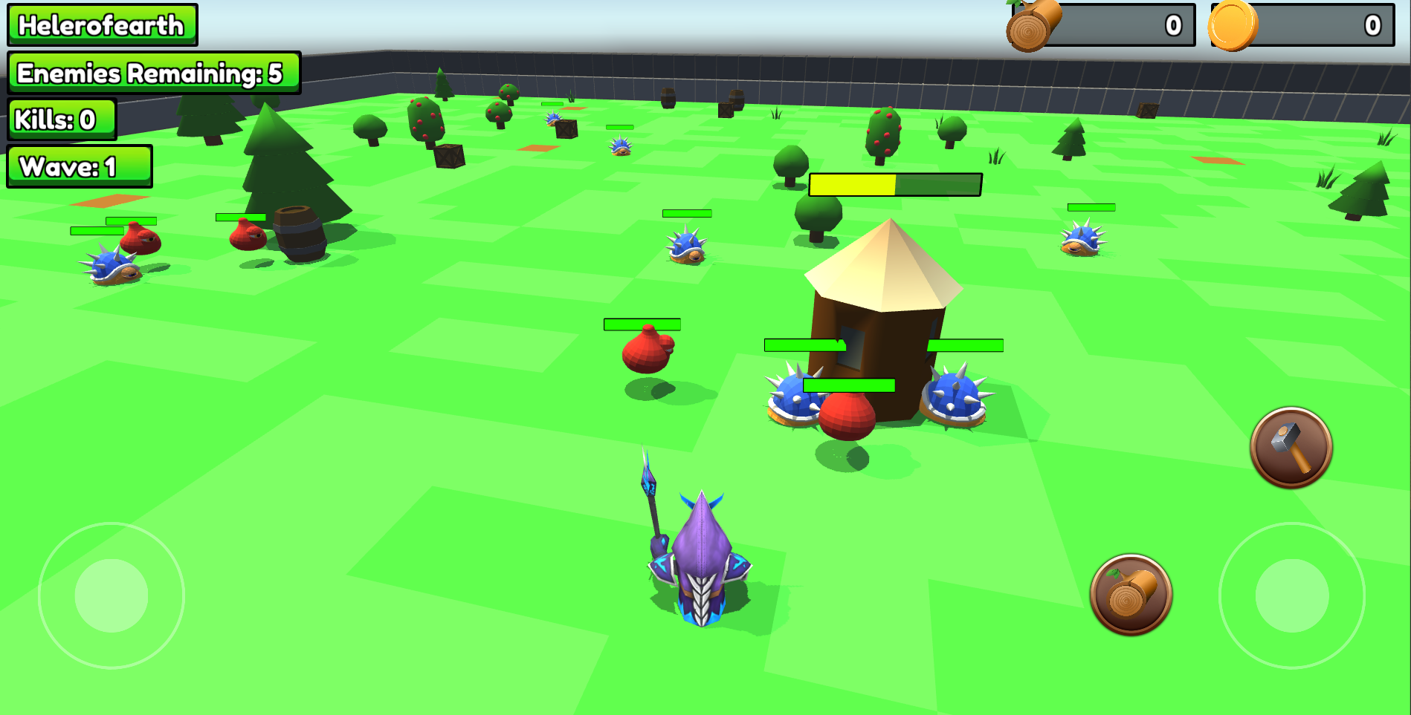
Defence Structure HP
Defence structure has modular HP
If need be later on we can change the health of the structure and even allow defence and damage modifiers.
HP is properly being displayed above the defence structure
Green
Yellow
Red

Slide 5
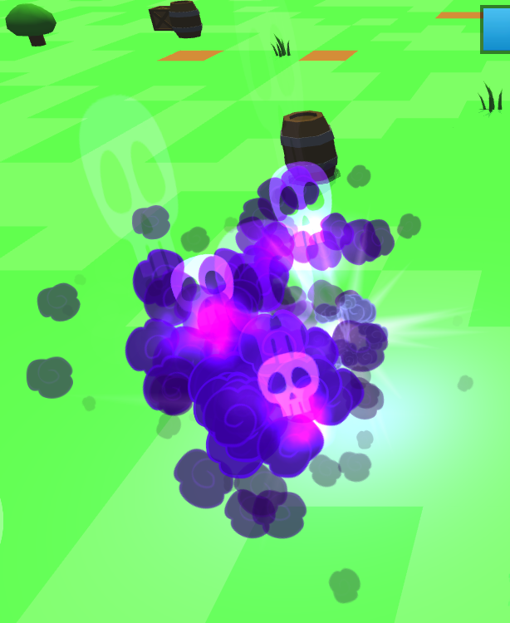
Damage Ability
Damage Ability added to the game to allow you to point and click to do damage.
Range is unlimited but will only spawn on the ground.
It does AOE (Area of Effect) damage to all enemies in its radius

Slide 6
Menu Update
Fixed issue where settings popup would be off-center
Audio settings now carry over from Landing scene to Start Scene.
Theme slider will now effect which world type is generated (forest and desert only)
Re-added menu button to start scene
Added game-over scene when the hut is destroyed by monsters.

Slide 7
Quality Assurance Testing
Highlights:
Email verification now works for all types of email accounts
Enemy health bars are working as intended
Cannon functionality is working as intended for gameplay
Leaderboard changes are working properly
More enemies spawning are working
New AOE tap mechanic is working as intended
Enemies remaining counter working properly
Resource counters updating properly

Slide 8
Goals Before the Dry Run
Very intensive QA
Various little code tweaks
Website functionality updates
Move final build of game onto website

Slide 9
Demo

